Slide 1
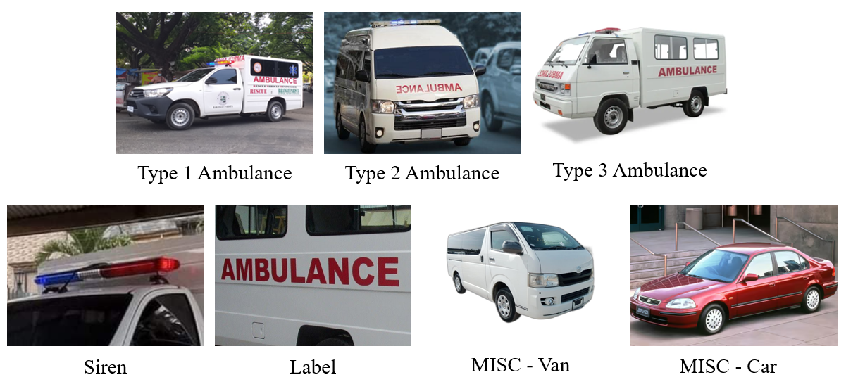
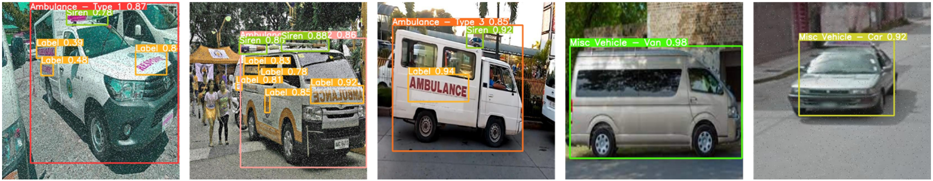
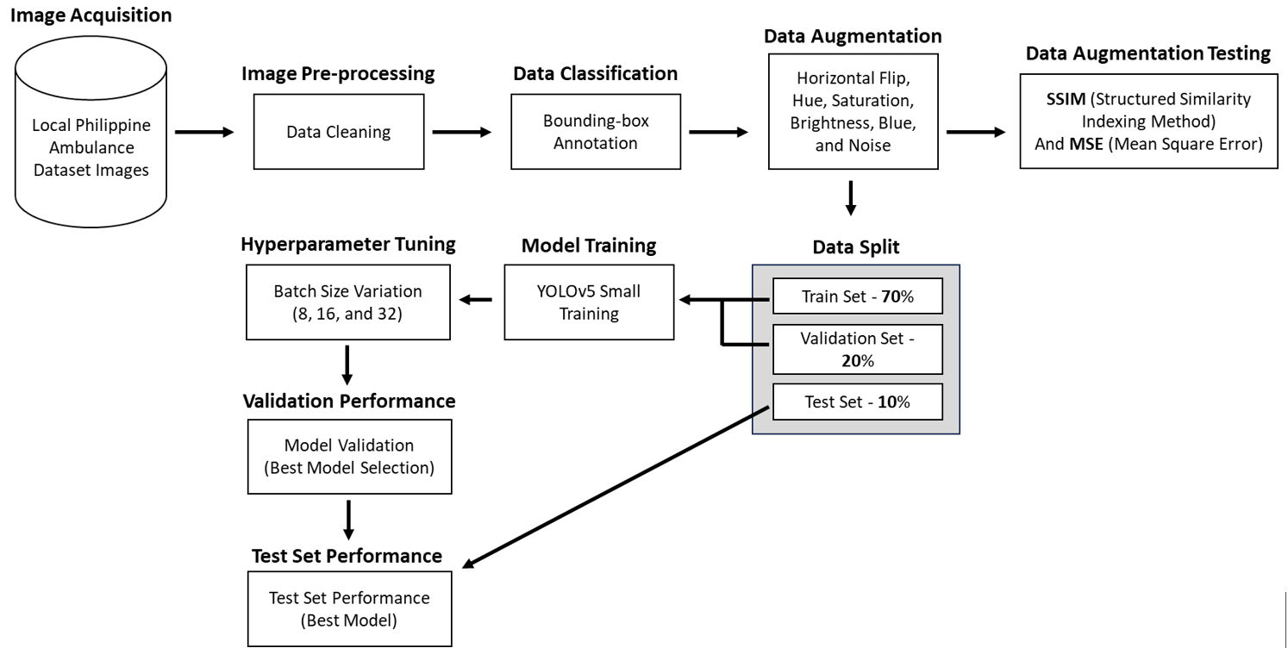
A Computer Vision Approach to Ambulance Classification in the Philippines using YOLOv5 Small
Steve Vincent Phillip C. Feria, Jose Rafael A. Franco, Hans C. Laguna
School of IT, Mapúa University
INTRODUCTION
CONCLUSION
One of the major problems that the Philippines is continuously facing is heavy traffic. This main problem leads to sub-problems that produce negative impacts on society [31]. A big portion of the medical field is affected, particularly to the emergency response vehicles or the ambulances. With this, the study describes the development of an object detection model that uses YOLOv5 Small to detect and classify the ambulances on the road, identifying them based on numerous types and attributes. In this study, the researchers set the following questions that will serve as a guide towards the objectives. (1) Is the YOLOv5s model able to attain high performance metrics in detecting and classifying different types of Philippine ambulances and its features? (2) By using the Structural Similarity Index (SSIM) to evaluate the dissimilarity between clean and augmented images, what is the average SSIM score, on a scale from 0 to 1, indicating the degree of diversity and non-redundancy achieved in the dataset? (3) By applying hyperparameter tuning, what is the optimal set of hyperparameters that should be used to maximize the performance of the YOLOv5s model? This study is made to close gaps and open opportunities. These are mainly the opportunity to bring computer vision application in terms of ambulance classification, the use of a small weight model for YOLOv5, and the opportunity to explore augmentation techniques with different hyperparameter tuning. Main significance of the paper is to make a cost-effective alternative to the traditional way of detecting ambulance and be able to test the best hyperparameter tuning. Furthermore, the study is limited to the utility of YOLOv5 model with small weight, application of the augmentation techniques of Flip, Hue, Saturation, Brightness, Bluer, and Noise, and hyperparameter tuning which includes the batch sizes for 8, 16, and 32. The dataset will be localized which includes the Philippine ambulances and the three types which are the type I, II, and III. The figure 1 below shows the different classes and types of vehicles that are included in the study. Figure 2 shows the effective detection and classification of the ambulances using the YOLOv5 small model.
To classify ambulances according to its different types namely type 1, type 2, and type 3, this study had several objectives. The primary objective of this study was to evaluate the performance metrics of the YOLOv5 model, with a specific focus on its small weight configuration. The task involved the detection and classification of Philippines ambulances, along with the identification of key features. The achieved validation score of 92.8% mAP and a test score of 93% indicate a robust and reliable performance of the YOLOv5 model in meeting the specified objectives. The high accuracy in both validation and test phases highlights the model's proficiency in detecting and classifying Philippines ambulances, thus fulfilling the first research objective.
The second objective aimed to assess the dissimilarity between clean and augmented images using the Structural Similarity Index (SSIM). The obtained SSIM score of 0.1574 indicates a low structural similarity between the original and augmented images. This low SSIM score suggests that the augmentation process introduced significant diversity and non-redundancy into the dataset. A low SSIM score is desirable in this context, as it reflects the successful augmentation of the dataset, meeting the intended purpose of creating diverse and non-redundant data.
The third objective involved the identification of the right set of hyperparameters for the YOLOv5 small model through hyperparameter tuning. The experimentation with different batch sizes (8, 16, and 32) while maintaining a constant epoch of 150 revealed that a batch size of 8 yielded the best results. The selected batch size achieved a validation score of 92.8%, showcasing the effectiveness of hyperparameter tuning in maximizing the model's performance. This finding affirms the importance of fine-tuning hyperparameters for optimal results in object detection tasks using the YOLOv5 model.
RECOMMENDATION
This study has seen promising evidence that implementation of an ambulance vehicle detection and classification. However, further research is needed to build, strengthen, validate, and to advance these findings. Implementing advanced optimization techniques may further enhance the YOLOv5 model's performance. Exploring methods such as fine-tuning, transfer learning, or leveraging more sophisticated architectures could lead to improved accuracy and efficiency in detecting and classifying Philippine ambulances. Continuous refinement of the model through optimization is essential for ensuring its reliability in practical deployment. Recognizing the potential real-world impact of the model, it is recommended to explore applications in prioritizing ambulances at intersections. This would involve studying the model's performance in identifying and prioritizing emergency vehicles in traffic, thereby contributing to more efficient emergency response systems in the Philippines.
To ensure robust performance across various real-world scenarios, efforts should be made to create a more uniform dataset. This includes capturing images under different lighting conditions, weather scenarios, and traffic densities. A uniform dataset will contribute to a more generalized model that can effectively handle the diverse conditions encountered in the Philippines setting. Recognizing that real-world scenarios are dynamic; it is crucial to establish a system for continuous monitoring and updates. Regularly updating the model with new data and adapting it to evolving conditions will ensure its continued effectiveness in the ever-changing environment of Philippine traffic management.
REFERENCES
[1] R. Dey, B. K. Pandit, A. Ganguly, A. Chakraborty and A. Banerjee, "Deep Neural Network Based Multi-Object Detection for Real-time Aerial Surveillance," 2023 11th International Symposium on Electronic Systems Devices and Computing (ESDC), Sri City, India, 2023, pp. 1-6, doi: 10.1109/ESDC56251.2023.10149866.
[2] X. Song and W. Gu, "Multi-objective real-time vehicle detection method based on yolov5," 2021 International Symposium on Artificial Intelligence and its Application on Media (ISAIAM), Xi'an, China, 2021, pp. 142-145, doi: 10.1109/ISAIAM53259.2021.00037.
[3] R. Yagfarov, V. Ostankovich and S. Gafurov, "Augmentation-Based Object Detection for Winter Time Applications," 2019 3rd School on Dynamics of Complex Networks and their Application in Intellectual Robotics (DCNAIR), Innopolis, Russia, 2019, pp. 178-180, doi: 10.1109/DCNAIR.2019.8875557.
[4] R. Anil, M. Satyakumar, and Ameena Salim. 2019. Emergency vehicle signal pre-emption system for heterogeneous traffic condition : A case study in Trivandrum City. 2019 4th International Conference on Intelligent Transportation Engineering (ICITE) (2019). DOI:http://dx.doi.org/10.1109/icite.2019.8880151
[5]Weiqi Yu, Weichen Bai, Wenjing Luan, and Liang Qi. 2022. State-of-the-art review on Traffic Control Strategies for Emergency vehicles. IEEE Access 10 (2022), 109729–109742. DOI:http://dx.doi.org/10.1109/access.2022.3213798
[6] Muhammad Azhad Bin Zuraimi and Fadhlan Hafizhelmi Kamaru Zaman. 2021. Vehicle detection and tracking using Yolo and DeepSORT. 2021 IEEE 11th IEEE Symposium on Computer Applications & Industrial Electronics (ISCAIE) (2021). DOI:http://dx.doi.org/10.1109/iscaie51753.2021.9431784
[7] Xiaohui Guan and Xinxin Sun. 2022. Vehicle identification and traffic statistics system in traffic intersection. 2022 4th International Conference on Intelligent Control, Measurement and Signal Processing (ICMSP) (2022). DOI:http://dx.doi.org/10.1109/icmsp55950.2022.9858960
[8] Jiaxing Zhang, Wen Xiao, Benjamin Coifman, and Jon P. Mills. 2020. Vehicle Tracking and Speed Estimation from Roadside Lidar. IEEE Journal of Selected Topics in Applied Earth Observations and Remote Sensing 13 (2020), 5597–5608. DOI:http://dx.doi.org/10.1109/jstars.2020.3024921
[9]Yunzhen Wang, Hongbing Ma, and Liangliang Li. 2022. Road traffic vehicle detection method using lightweight yolov5 and attention mechanism. 2022 7th International Conference on Image, Vision and Computing (ICIVC) (2022). DOI:http://dx.doi.org/10.1109/icivc55077.2022.9886525
[10] Chengpeng Wang, Huanqin Wang, Fajun Yu, and Wangjin Xia. 2021. A high-precision fast smoky vehicle detection method based on improved Yolov5 Network. 2021 IEEE International Conference on Artificial Intelligence and Industrial Design (AIID) (2021). DOI:http://dx.doi.org/10.1109/aiid51893.2021.9456462
[11] Othman O. Khalifa, Muhammad H. Wajdi, Rashid A. Saeed, Aisha H. Hashim, Muhammed Z. Ahmed, and Elmustafa Sayed Ali. 2022. Vehicle detection for vision-based intelligent transportation systems using convolutional neural network algorithm. Journal of Advanced Transportation 2022 (2022), 1–11. DOI:http://dx.doi.org/10.1155/2022/9189600
[12] Zhuang Li, Xincheng Tian, Yan Liu, and Xiaorui Shi. 2022. Vehicle tracking method based on attention-yolov5 and optimized DeepSort models. 2022 IEEE 11th Data Driven Control and Learning Systems Conference (DDCLS) (2022). DOI:http://dx.doi.org/10.1109/ddcls55054.2022.9858395
[13] Fuheng Guo and Yi Xu. 2022. Vehicle Analysis System based on DeepSORT and yolov5. 2022 3rd International Conference on Computer Vision, Image and Deep Learning & International Conference on Computer Engineering and Applications (CVIDL & ICCEA) (2022). DOI:http://dx.doi.org/10.1109/cvidliccea56201.2022.9824363
[14] Jiandong Wang, Yahui Dong, Shuangrui Zhao, and Zhiwei Zhang. 2023. A high-precision vehicle detection and tracking method based on the attention mechanism. Sensors 23, 2 (2023), 724. DOI:http://dx.doi.org/10.3390/s23020724
[15] Liu Xiaomeng, Feng Jun, and Chen Peng. 2022. Vehicle detection in traffic monitoring scenes based on improved Yolov5s. 2022 International Conference on Computer Engineering and Artificial Intelligence (ICCEAI) (2022). DOI:http://dx.doi.org/10.1109/icceai55464.2022.00103
[16] Baoping Xiao, Jinghua Guo, and Zhifei He. 2021. Real-time object detection algorithm of autonomous vehicles based on improved Yolov5s. 2021 5th CAA International Conference on Vehicular Control and Intelligence (CVCI) (2021). DOI:http://dx.doi.org/10.1109/cvci54083.2021.9661149
[17] Xuyang Song and Wei Gu. 2021. Multi-objective real-time vehicle detection method based on Yolov5. 2021 International Symposium on Artificial Intelligence and its Application on Media (ISAIAM) (2021). DOI:http://dx.doi.org/10.1109/isaiam53259.2021.00037
[18] Lei Shao, Zhenqiang Fan, Ji Li, and Hongli Liu. 2022. Research on road vehicle detection based on improved Yolov5s. 2022 IEEE International Conference on Mechatronics and Automation (ICMA) (2022). DOI:http://dx.doi.org/10.1109/icma54519.2022.9856288
[19] Erika Ritzelle Bondoc, Francis Percival Caparas, John Eddie Macias, Vileser T. Naculangga, and Jheanel E. Estrada. 2018. An intelligent road traffic information system using text analysis in the most congested roads in Metro Manila. 2018 IEEE 10th International Conference on Humanoid, Nanotechnology, Information Technology,Communication and Control, Environment and Management (HNICEM) (2018). DOI:http://dx.doi.org/10.1109/hnicem.2018.8666416
[20] L. -S. Tseng, C. -H. Wu, Y. H. Chen and C. -H. Tsai, GAN-based Data Augmentation for Metal Surface Defect Detection Using Convolutional Neural Networks. (2023). Ieeexplore.ieee.org. Retrieved October 12, 2023, from https://ieeexplore.ieee.org/document/10219520
OBJECTIVES
This project aims to develop a customized vehicle dataset for ambulance detection in the Philippines and explore the scalability of an existing framework to create an improved YOLO model (YOLOv5s) for identifying ambulances different types and classes among standard vehicles on the road, facilitating their prioritization in traffic. The objective is to expedite ambulance travel times, enhancing patient care, and be able to utilize a model with hyperparameter tuning and augmentation techniques applied that is accurate for detecting and classifying the types of ambulances on the road. The researchers have created the following objective declarations to meet the research's goals:
Assess the performance metrics of the YOLOv5 model, specifically in the small weight, in detecting and classifying Philippines ambulances and their key features.
To assess the dissimilarity between clean and augmented images using SSIM in order to determine the average Structural Similarity Index (SSIM) score, which would reflect the diversity and non-redundancy attained in the dataset.
To identify the right set hyperparameters through hyperparameter tuning in order to maximize the performance of the YOLOv5 small model.
CONCEPTUAL FRAMEWORK
This section discusses the process of detecting and classifying Philippine ambulances using the proposed framework. Since there's a lack of research on ambulance detection models specific to this region, the researchers aim to utilize an existing YOLO object detection model with a localized dataset of Philippine ambulances. Collecting the dataset involves considering parameters such as ambulance type, siren lights, and label lettering. The methodology process involves data acquisition, image preprocessing, model training, and performance testing, all to improve ambulance detection through computer vision.

